Slide 1
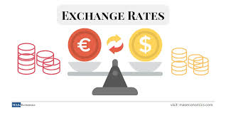
EXCHANGE RATE
Jamel Ben Chafra

Slide 2
WHAT IS EXCHANGE RATE?
Value of a nation’s currency when it is traded for another currency.
Relative price of one currency expressed in terms of another currency.
Amount of domestic currency required to purchase one unit of foreign currency.
Notes:
Provide the following example: The exchange rate from Euros to U.S. dollars was 1.07 at the end of June 2024.

Slide 3
Monthly Average Exchange Rate (Euro to U.S. dollar)
Month (2024) | Average Exchange Rate
January | 1.09
February | 1.08
March | 1.09
April | 1.07
May | 1.08
June | 1.08
July | 1.09
August | 1.10
September | 1.11

Slide 4
Factors affecting exchange rates
Differentials in inflation rate
Differentials in interest rates
Current account deficits
Public debt
Terms of trade

Slide 5
Strongest currencies in the world
Kuwaiti Dinar
Bahraini Dinar
Omani Rial
Jordanian Dinar

Slide 6
Strongest currencies in the world
Kuwaiti Dinar
Bahraini Dinar
Omani Rial
Jordanian Dinar
British Pound

Slide 7
1 USD = 34.25 TRL

